Slide 1
Deep Reinforcement Learning in the game of “7 Wonders”
DAWIEANG Phudis
Supervisor : Dr. Antoni Chan

Slide 2
Contents
Introduction
Motivation
Goals of the project
Project design
Experiments and results
Analysis
Future works

Slide 3
Introduction

Slide 4
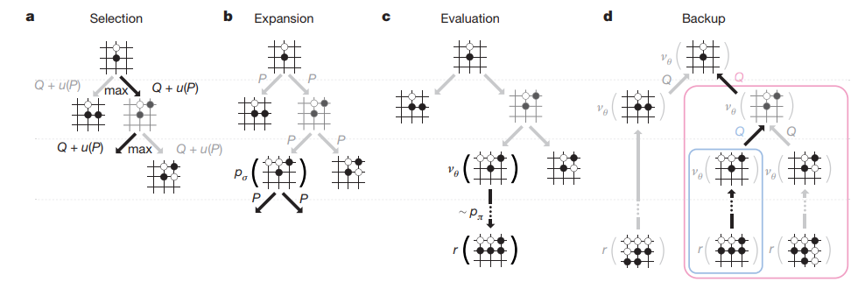
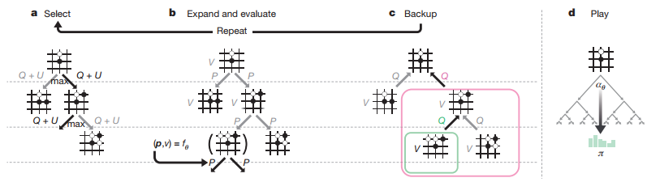
Reinforcement Learning in Games
AlphaGo : Monte Carlo Tree Search (MCTS)
Result : 4-1 wins against Lee Sedol, a top human pro at that time. ⁽¹⁾
AlphaGo Zero : Self-play MCTS
Result : 89-11 games against AlphaGo
(1) Silver, D., Huang, A., Maddison, C. J., Guez, A., Sifre, L., van den Driessche, G., Schrittwieser, J., Antonoglou, I., Panneershelvam, V., Lanctot, M., Dieleman, S., Grewe, D., Nham, J., Kalchbrenner, N., Sutskever, I., Lillicrap, T., Leach, M., Kavukcuoglu, K., Graepel, T., & Hassabis, D. (2016). Mastering the game of Go with deep neural networks and tree search. Nature, 529(7587), 484–489. https://doi.org/10.1038/nature16961
(2) Silver, D., Schrittwieser, J., Simonyan, K., Antonoglou, I., Huang, A., Guez, A., Hubert, T., Baker, L., Lai, M., Bolton, A., Chen, Y., Lillicrap, T., Hui, F., Sifre, L., van den Driessche, G., Graepel, T., & Hassabis, D. (2017). Mastering the game of Go without human knowledge. Nature, 550(7676), 354–359. https://doi.org/10.1038/nature24270

Slide 5
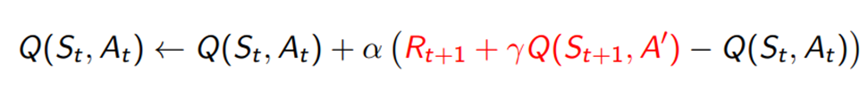
Deep Q-Learning (DQL)
Q-learning is the reinforcement learning algorithm for finding next best move using the Q-value. It has three main steps
Initializing the state-action Q-value table
Explore next states, find the reward
Update the Q-value of the state-action pair using the formula
When R_t+1 is real reward, and Q(S_t+1,A’) is estimated of Q-value from optimal action A’
After that, 2. and 3. is repeated.
Deep Q-learning is Q-learning but replace the state-action table by using transformer/neural network instead

Slide 6
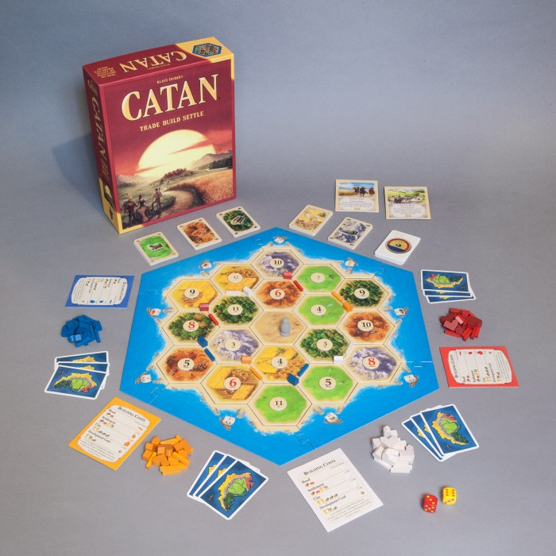
Eurogames
European table-top board games.
Contrast with American board games (Monopoly, Uno, etc.)
Less luck involved, more critical planning
No player elimination
Examples are Catan, Power Grid, Carcassonne.
It is interested in AI games research because, unlike other board games
It is non-deterministic, but still have lots of strategies involved.
More than 2 players involved
Partially-observable (Hidden information existed)
Catan

Slide 7
7 Wonders
3-7 Players, partially observable and stochastic games.
Objective is to get the highest Victory Points (VPs) possible by building constructions (represents in cards), trading, upgrading your “Wonders”, etc.
Each game will have 3 Age. Cards in later Age will require more resources built in previous ages, but also have higher impacts on the VPs.
In each age, player will start with 7 age-specific cards on hand. Each age will have 6 turns. In each turn, player will have a choice to
Play a card (and pay neighbors for resources if required)
Discard a card for 3 coins
Upgrade/build a stage for wonders, which will have various effects depend on wonders (and pay neighbors for resources if required)
After playing the card, the cards on hand will be rotated clockwise (1st and 3rd age) or anticlockwise(2nd age) For 6th turn in each age, last card will be discarded.

Slide 8
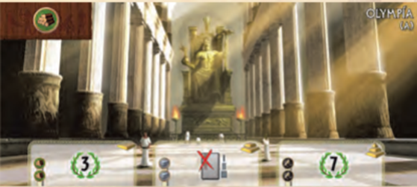

7 Wonders (cont)
Each wonders will have 2 sides. Each wonders and sides will have different effects. For example, Olymipia (A) 2nd stage, when built, has an effect of playing 1 card for free per age.
Cards are consisted of 7 different types, which are raw materials, manufactured goods, civilian structures, scientific structures, commercial structures, military structures and guilds. Each cards have different effects. For example, civilian = pure VP or Military gives combat score.
At the end of each age, military conflict will occur by comparing combat score with neighbors’ wonders. Winners get 2*age-1 VP, losers lose 1 VP.
At the end of each game, VP is calculated by
$$VP_{total}=\left(military VP\right)+\left\lfloor \frac{coins}{3}\right\rfloor +\left(wonders VP\right)+\left(civilian VP\right)+\left(commercial VP\right)+\left(guild VP\right)+(scientific VP)$$

Slide 9
Previous research on other Eurogames
Catan (Fully observable, stochastic with more than 2 players)
MCTS (2010)³
However, in this research, trading is removed for the MCTS agent. Card system is also removed.
Q-learning (2019)⁴ with Long Short-Term Memory
However, in this research, the researcher only on the trading aspect of the game and let the existing bot from jSettlers help on infrastructure construction part of the game.
This algorithm is tested to be better than multiple algorithms based on MCTS, such as UCT,
7 Wonders
MCTS (2014)
It is proved to be better than Rule-based AI
However, it considers only the Card itself, not the Wonder board.
It can be seen that no other previous research has tried to research on the whole game environment.

Slide 10
OpenAI Gym
OpenAI Gym (https://gym.openai.com/) is an environment for training and testing Reinforcement Learning algorithm.
There are multiple Gyms for testing, for example, CartPole, Gridworld, etc.

Slide 11
Motivation

Slide 12
Motivation of this project.
Reinforcement Learning has many promising results in board games, such as AlphaGo Zero in game of Go.
In previous research, Deep Q-learning performs better than MCTS
Whole game environment in Eurogames are mostly not implemented, with the reason of too large action/state spaces.
7 Wonders have many problems to deal with, for example
Hidden information
Many possible actions depends on the board/hand
Etc.

Slide 13
Goals of the Project

Slide 14
Goals of the project
Create the 7 Wonders game (text-based)
Create the environment so that the 7 Wonders game can be used within outside the range of this project.
Be able to use deep Q-learning in a game of 7 Wonders, while tackles many problems in this game.

Slide 15
Project Design

Slide 16
Project Design
Three main parts of this projects are
7 Wonders Game, which have 2 main parts, Database (Cards and Wonders) and System
OpenAI Gym environment of the game
Deep Q-learning for the game

Slide 17
7 Wonders Game : Database - Wonders
For wonders, each wonders have
initial (initial resources on board)
Sides (A,B) Each sides will have
Stages, which are stage of each wonders (normally 3, but some will have 2 or 4)
Each stages will have
payResource, which is resources needed to pay to get the stage
getResource, which is resources the stage will provide
Resource will be mostly kept as a (type,amount) pair. However, some of the stages do not give resource, but give effects instead. These will be kept as (type,effect) instead. Also, some stages may not give/take only one type of resource.

Slide 18
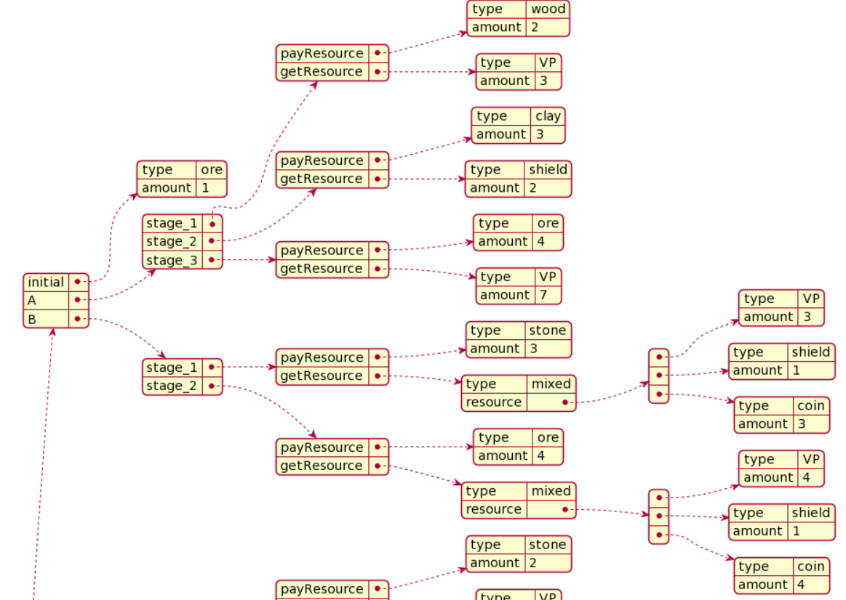

Slide 19
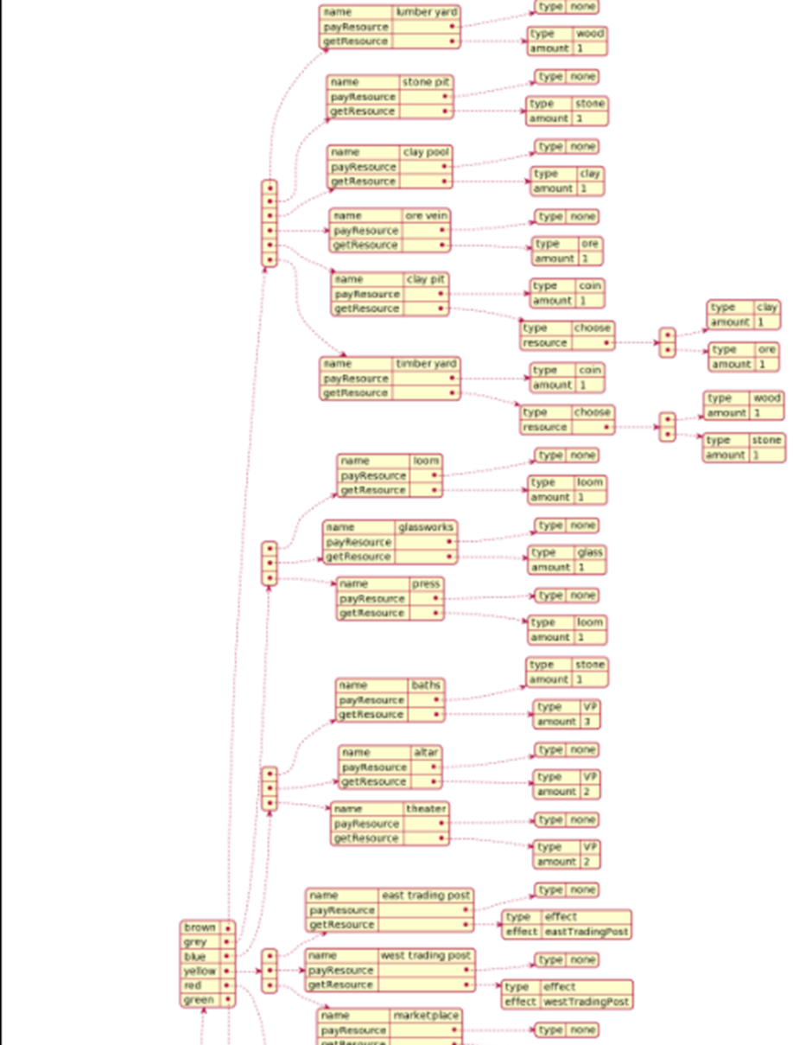
7 Wonders Game : Database - Cards
Cards are separated to Ages, then colors
Each card will have its name, payResource and getResource.

Slide 20
7 Wonders Game : System
There are multiple class for system, for example
Player class
Resource class
Wonder class
Card
Personality
Personality is important, because it will be used for testing our AI. There are 3 personality implemented
DQNAI : Our AI, which action will be decided by DQL
RandomAI : Decision is random through all possible actions in that turn.
RuleBasedAI : Decision is made from certain priority rules.

Slide 21
Personality : RuleBasedAI
For age 1 and 2 :
Upgrading the stage of wonders if it is available and free.
If it’s available but it’s not free, 50% to pay for stages and 50% to go to next rule
Select a card that provides more than one type of resource. If there are multiple cards satisfying this rule, randomly select one.
Select a card that provides mixed resource (For example, Clay Pit provides either brick or wood). If there are multiple cards satisfying this rule, randomly select one.
Select a card that provide resources that this player does not have yet. If there are multiple cards satisfying this rule, randomly select one.
Select military card if it makes this player’s military point supercedes the neighbor. If there are multiple cards satisfying this rule, randomly select one.
Select science card. If there are multiple cards satisfying this rule, randomly select one.
Select VP (civil) card. If there are multiple cards satisfying this rule, randomly select one.
Select an action that does not discard card. If there are multiple cards satisfying this rule, randomly select one.
Select any remaining playable action.
For age 3 : Selected the action that gives the most intermediate VP.

Slide 22
OpenAI Gym Environment
Custom environment implemented so it can be plugged in with our DQL. It has 4 main functions
Init : Initialize the environment
Step : Take an action. Return the current state, reward from that state, Boolean specifies if the game is done or not and other extra information.
Reset : reset the environment at the beginning of the episode
Render : Render the play in each episode. However, because the game is text-based and not graphical-based, the action can be seen in action log directly.
While 4 main functions can be implemented by adapting our finished game into our custom environment, there are some parts that needed to be implemented because it is not required in main game, which are states (observation_space) and action (action_space) of this environment.

Slide 23
SevenWonEnv Gym : States
States are defined as MultiDiscrete consisted of
resourceAmountOwn(11)
10 resources’ amount except the battle points are Discrete(5)^{(*)}
1 battle points as Discrete(20)
colorAmountOwn(7), each as Discrete(10)
ownEastTradingCost(7), each as Discrete(2)
ownCoin(1) as Discrete(100)
resourceAmountLeft(11)
colorAmountLeft(7)
resourceAmountRight(11)
colorAmountRight(7)
ageNumber(1) as Discrete (3)
Discrete(n) means that data is possible in [0,n) as an integer
Same as above

Slide 24
SevenWonEnv Gym : Actions
States are defined as Discrete(300). There are 300 actions possible, which its number can come from (cardCode,actionCode)
cardCode comes from each unique cards encoded into 0-74 (there are 74 unique cards, even though some cards may exist in game more than once)
actionCode are 0-4
0 = Play a card normally
1 = Play a card for free using effects (such as Olympia’s A’s 2nd stage effect that can play free card once per turn)
2 = Discard a card for 3 coins
3 = Upgrade a wonder

Slide 25
SevenWonEnv Gym : additional functions
There are some functions which is needed for the DQL training part.
actionToCode/codeToAction : Interchange the action and the actionCode to be used in the DQL as mentioned before.
LegalAction : Return the legal action of the player. This will be useful for action masking, which will be explained in the DQL session.
stateGenerator : Generate the current state as observation_space.
Reward is given at the end of the game. [2,1,-1,-2] for 1st,2nd,3rd and 4th place.
It’s not Victory Points because more points between games does not mean winning, especially when some cards have less impact during the game, and more impact in late-game situation.

Slide 26


Deep Q-learning
Two network, Policy network (for q-value prediction) and Target network (to calculate loss of the policy network prediction)
Consist of 5 layers implemented in PyTorch
Linear(70,140)
LayerNorm(140)
Linear(140,200)
LayerNorm(200)
Linear(200,300)
Action will be selected by decaying ε-greedy policy. Random number r will be generated between 0 to 1, and then the action a is decided by following formula
$$a= \left\{\begin{aligned}&a_{g} ;r<ε \\ &a_{r} ;otherwise\end{aligned}\right.$$
$$ε=ε_{t}+\frac{ε_{s}−ε_{t}}{e^{\left(−\frac{episode}{ε_{d}}\right)}}$$

Slide 27

Deep Q-learning - Masking
However, output from this neural network cannot be used directly because most of the time, action will be invalid.
Masking is needed to mask invalid action out.
Masking is done by converting list of legal action code retrieved from legalAction function to list of zeros and ones
Greedy action can be retrieved by taking Hadamard product between output layer Vo and masking vector M, normalize the value to between 0-1, then find the action number that gives the maximum value.
Random action can be retrieved by randomly select on of the possible action.
In each action, if payment is required, the payment will be made greedily that the player will have to pay the least amount of money.
$$M\left[i\right]=\left\{\begin{aligned}&1;i∈L \\ &0 ;otherwise\end{aligned}\right.$$
$$a_{g}=\underset{a∈L}{argmax}\left(V_{o}∘M\right)\left(a\right)$$
$$a_{r}=\underset{a∈L}{rand}{a}$$

Slide 28

Deep Q-learning - Reward
Reward is discounted by some values between 0 to 1.
$$r_{s,i}={\left(k\right)}^{n−i}r_{n}$$
n = amount of total actions
$r_{s,i}$ = reward for the action i in state s
k = discounted rate

Slide 29
Experiment and Results

Slide 30
Experiment
2 batch of experiment
3 players' batch
2RandomAI + 1 DQNAI
1RandomAI + 1 RuleBasedAI + 1DQNAI
4 players’ batch
3RandomAI + 1 DQNAI
2RandomAI + 1 RuleBasedAI + 1 DQNAI
1RandomAI + 2 RuleBasedAI + 1 DQNAI
Fixed parameters
Decaying reward rate k = 0.95
Terminal threshold ε_t = 0.05
Initial threshold ε_s = 0.9
The ε decaying rate ε_d = 2500
Target Network update every 10 episodes
Max Episode = 2600
Rewards mentioned above for each game.
Batch size for loss function = 128
Gamma for expected Q value calculation = 0.99

Slide 31
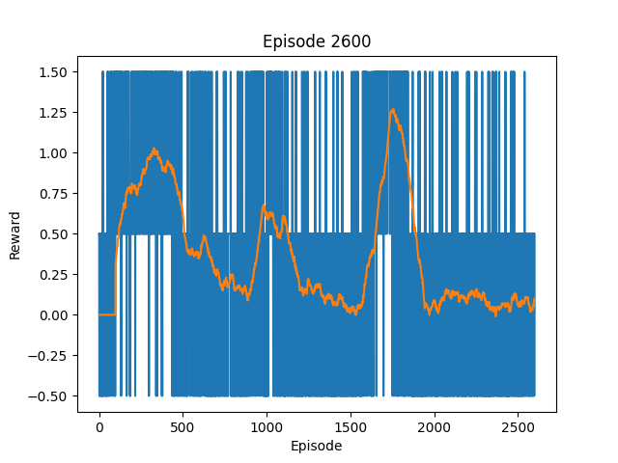
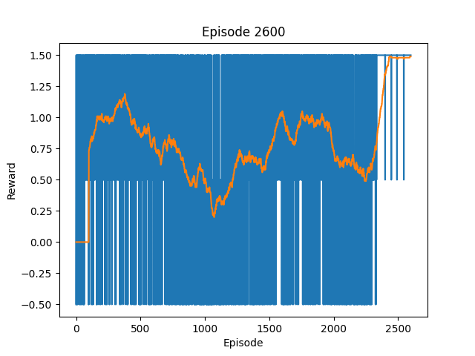
Results – 3 Players
1RandomAI+1RuleBasedAI+1DQNAI
2RandomAI+1DQNAI

Slide 32
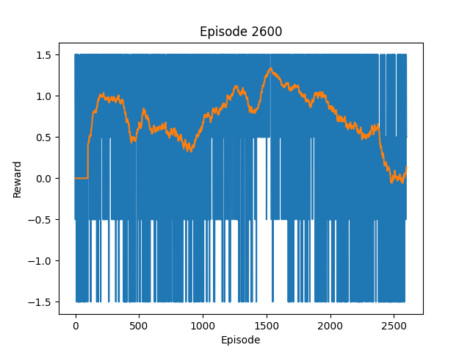
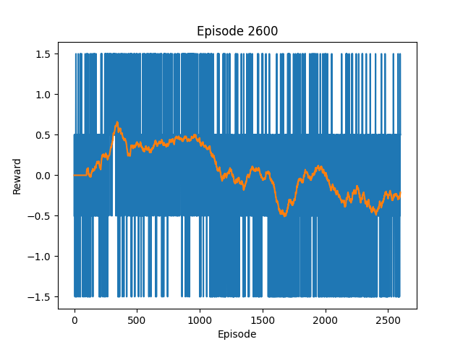
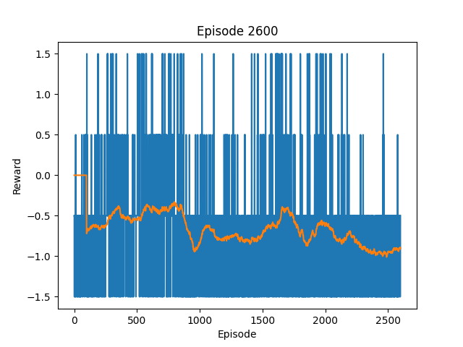
Results – 4 Players
3RandomAI+1DQNAI
2RandomAI+1RuleBasedAI+1DQNAI
1RandomAI+2RuleBasedAI+1DQNAI

Slide 33
Analysis

Slide 34
Result Analysis
The DQNAI can consistently win against the RandomAI, however it cannot win against the RuleBasedAI.
RuleBasedAI gains much higher points in 3rd stage, because it evaluates all possible moves, then select ones that get the most intermediate VP.
There are 4 points that make the DQNAI has a disappointing result
2600 Episodes may not be enough amount of episode to train the AI.
Parameter tuning may be needed
The model does NOT know directly about the illegal actions. While it may notice that the action is selected, it does not really know which action is legal or illegal
Type of NN

Slide 35
Project Result
Text-based 7 Wonders game is completely implemented in Python
Custom OpenAI Gym for 7 Wonders game is also complete in Python
DQNAI works fairly, but not good enough to beat Rule-based AI. Further research is required on how to improve the DQNAI.

Slide 36
Future Plans

Slide 37
Future Plans
Improving the DQNAI. There are many approaches to this, for example
Changing the Neural Network structure
Use other algorithms. For example, Fictitious Self-Play (FSP), Duelling deep Q-network, etc.
Parameter Tuning
Etc.
Implement the 7 Wonders game with graphical interface, then connect it with the current 7 Wonders OpenAI Gym.

Slide 38
Reference
Robilliard, D., Fonlupt, C., & Teytaud, F. (2014). Monte-Carlo Tree Search for the Game of “7 Wonders”. Communications in Computer and Information Science Computer Games, 64-77. doi:10.1007/978-3-319-14923-3_5
Szita, I., Chaslot, G., & Spronck, P. (2010). Monte-Carlo Tree Search in Settlers of Catan. Lecture Notes in Computer Science Advances in Computer Games, 21-32. doi:10.1007/978-3-642-12993-3_3
Xenou, K., Chalkiadakis, G., & Afantenos, S. (2019). Deep Reinforcement Learning in Strategic Board Game Environments. Multi-Agent Systems Lecture Notes in Computer Science, 233-248. doi:10.1007/978-3-030-14174-5_16
Joaquim A., Gabriel P., Julia A., Rafael V. & Lana R. (2019). Data mining 7 Wonders, the board game. Paper presented in Proceedings of SBGames 2019, Rio de Janeiro, Brazil
Shao, Kun & Tang, Zhentao & Zhu, Yuanheng & Li, Nannan & Zhao, Dongbin. (2019). A Survey of Deep Reinforcement Learning in Video Games.
Niklaus, J., Alberti, M., Pondenkandath, V., Ingold, R., & Liwicki, M. (2019). Survey of Artificial Intelligence for Card Games and Its Application to the Swiss Game Jass. 2019 6th Swiss Conference on Data Science (SDS). doi:10.1109/sds.2019.00-12
Browne, C. et al. A survey of Monte-Carlo tree search methods. IEEE Trans. Comput. Intell. AI in Games 4, 1–43 (2012)
Silver, D., Huang, A., Maddison, C. et al. Mastering the game of Go with deep neural networks and tree search. Nature 529, 484–489 (2016). https://doi.org/10.1038/nature16961
Silver, D. (2015). Model-free Control. COMPM050 Reinforcement Learning. London; University College London.
Silver, D., Hubert, T., Schrittwieser, J., Antonoglou, I., Lai, M., Guez, A., Lanctot, M., Sifre, L., Kumaran, D., Graepel, T., Lillicrap, T., Simonyan, K., & Hassabis, D. (2018). A general reinforcement learning algorithm that masters chess, shogi, and Go through self-play. Science, 362(6419), 1140–1144. https://doi.org/10.1126/science.aar6404
Mnih, V., Kavukcuoglu, K., Silver, D., Graves, A., Antonoglou, I., Wierstra, D., & Riedmiller, M. (2013). Playing atari with deep reinforcement learning. ArXiv:1312.5602 [Cs]. http://arxiv.org/abs/1312.5602
Adil Khan, Jiang, F., Liu, S., &amp; Omara, I. (2019). Playing a FPS Doom Video Game with Deep Visual Reinforcement Learning. Automatic Control and Computer Sciences, 53(3), 214–222. https://doi.org/10.3103/s0146411619030052
Brockman, G. et al., 2016. Openai gym. arXiv preprint arXiv:1606.01540.
Reinforcement Learning II: A2C. Bot Bowl. (n.d.). https://njustesen.github.io/ffai/a2c.html.

